Slide 1
Lecture 2: Foundation of Biomedical Imaging
2/27/2024
Dr. Guohua Cao （曹国华） caogh@shanghaitech.edu.cn
School of Biomedical Engineering
ShanghaiTech University

Slide 2
Lecture 2: Foundation of Biomedical Imaging
Common concepts in biomedical imaging
United view of imaging technologies
Current clinical practice of medical imaging
Image Storage: PACS & DICOM
Introduction to ImageJ
An image is a matrix!
Histogram
Image Display: Display Monitor, Window/Level
Image normalization
Terminologies in 2D & 3D imaging
Axial, Coronal, Sagital
MPR, Curved MPR, Volume Rendering, MinIP/AIP/MIP

Slide 3
Medical Imaging Modalities
List of major medical imaging modalities:
X-rays
CT (Computed Tomography)
MRI (Magnetic Resonance Imaging)
US (Ultrasound)
PET (Positron Emission Tomography)
SPECT (Single-Photon Emission Computed Tomography)
Multi-Modalities:
PET/CT
SPECT/CT
PET/MRI
…
Notes:
2D vs 3D

Slide 4
Unified view of imaging technologies

Slide 5
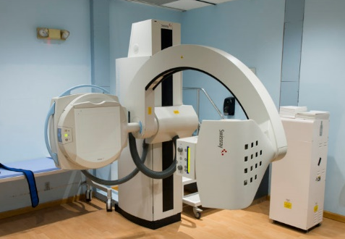
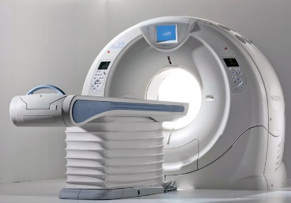
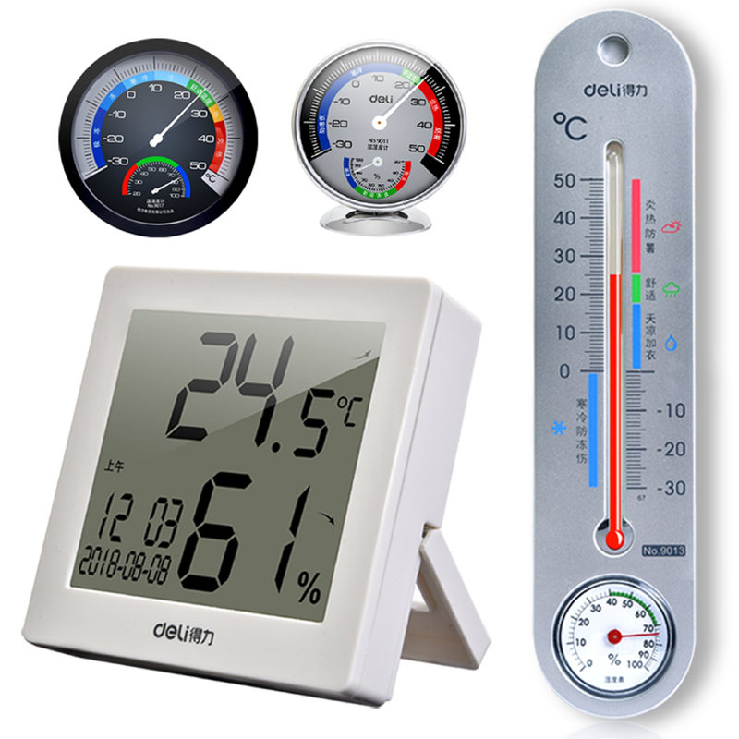
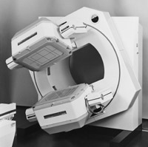
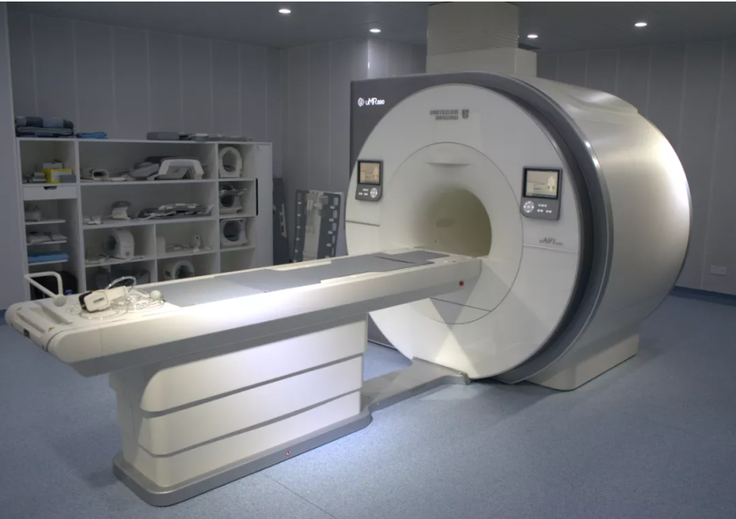
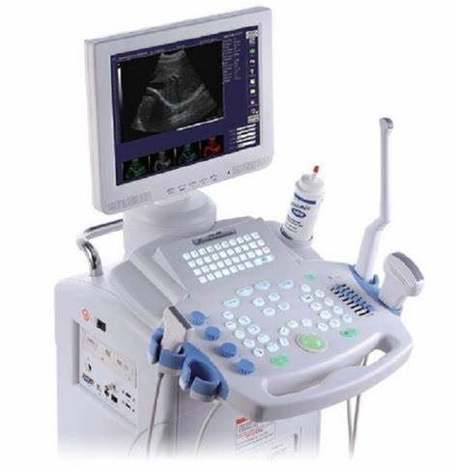
医学影像设备
~
温度计
X-ray
CT
MRI
SPECT
Ultrasound
PET

Slide 6



In dream - a Push-button Solution!
Acquisition
Reconstruction & Processing
Interpretation

Slide 7

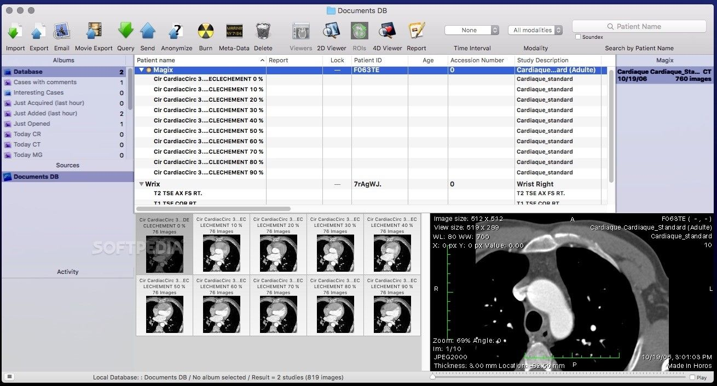


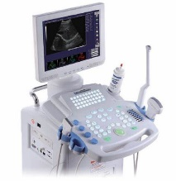
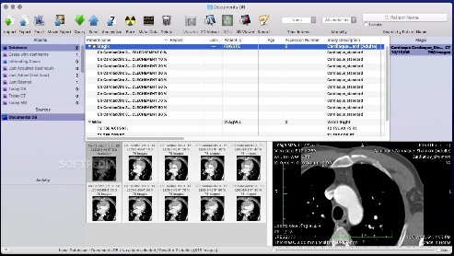

In reality, not there yet, but pretty cool.
Picture archiving and communication system (PACS)

Slide 8
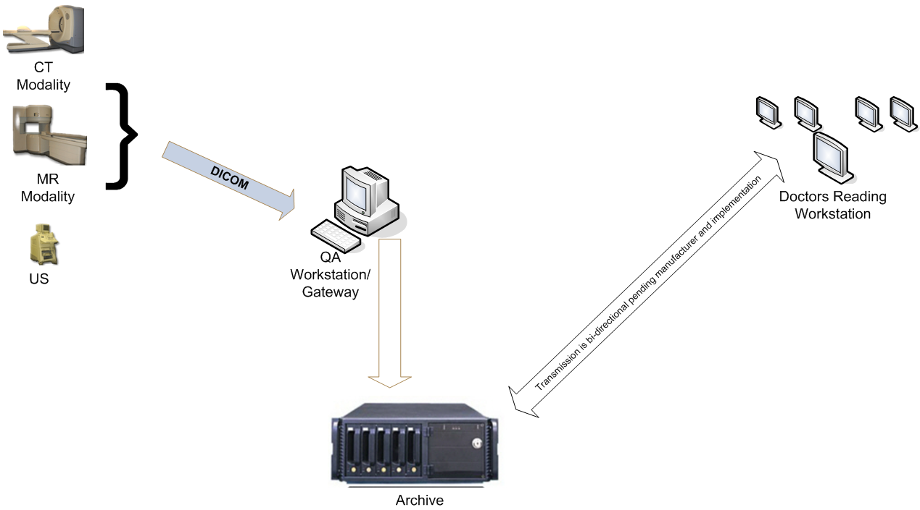
Image Storage: PACS & DICOM
A picture archiving and communication system (PACS) is a medical imaging technology which provides economical storage and convenient access to images from multiple modalities. Electronic images and reports are transmitted digitally via PACS; this eliminates the need to manually file, retrieve, or transport film jackets, the folders used to store and protect X-ray film. The universal format for PACS image storage and transfer is DICOM (Digital Imaging and Communications in Medicine).
DICOM is the standard for the communication and management of medical imaging information and related data. Also known as NEMA standard PS3, and as ISO standard 12052:2017 "Health informatics – Digital imaging and communication in medicine (DICOM) including workflow and data management“. DICOM standard is held by The National Electrical Manufacturers Association (NEMA) in the U.S.

Slide 9
Lecture 2: Foundation of Biomedical Imaging
Common concepts in biomedical imaging
United view of imaging technologies
Current clinical practice of medical imaging
Image Storage: PACS & DICOM
Introduction to ImageJ
An image is a matrix!
Histogram
Image Display: Display Monitor, Window/Level
Image normalization
Terminologies in 2D & 3D imaging
Axial, Coronal, Sagital
MPR, Curved MPR, Volume Rendering, MinIP/AIP/MIP

Slide 10
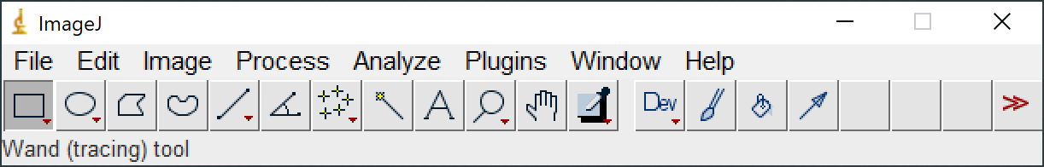
ImageJ
http://imagej.nih.gov/ij/
Useful for import/export, display, edit, and simple math including histogram & line intensity profile.
Excise yourself: Get your hands-on ImageJ.

Slide 11
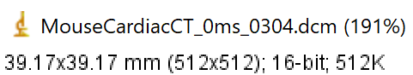
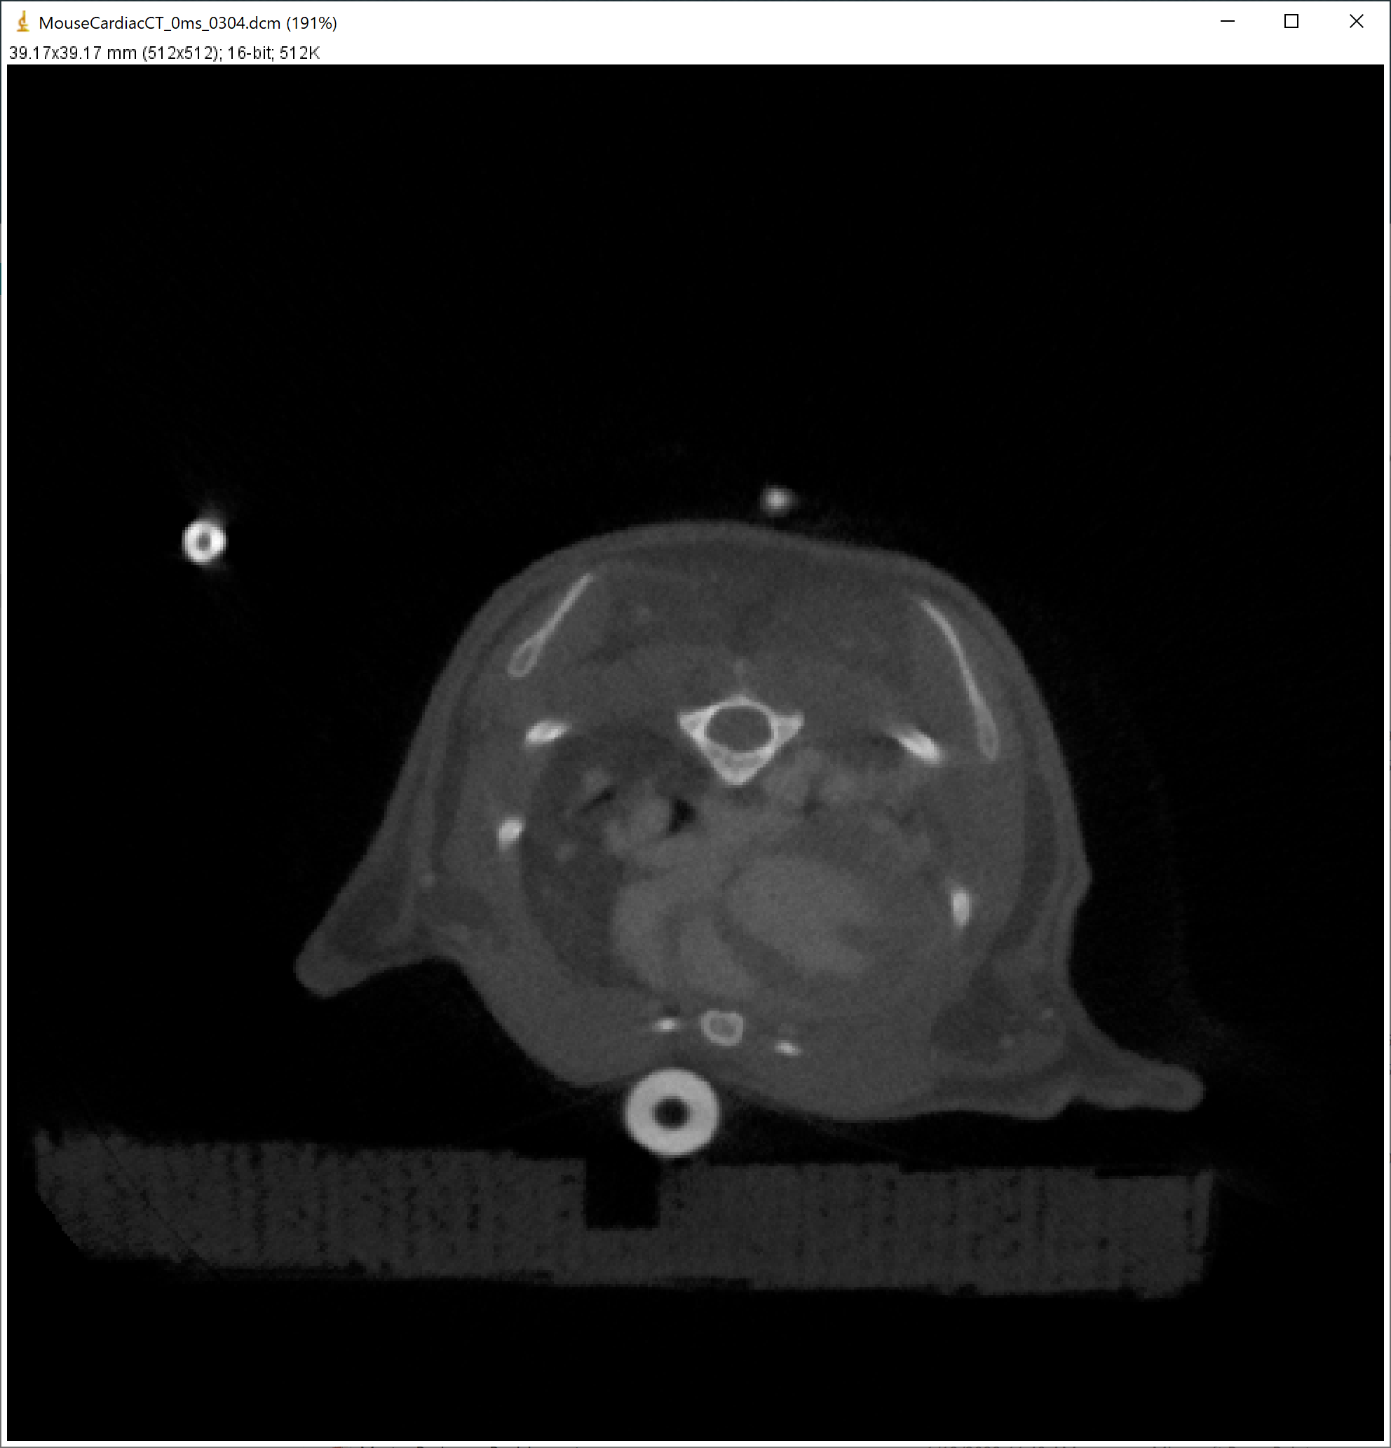
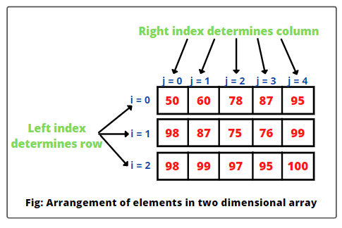
An image is a matrix!

Slide 12
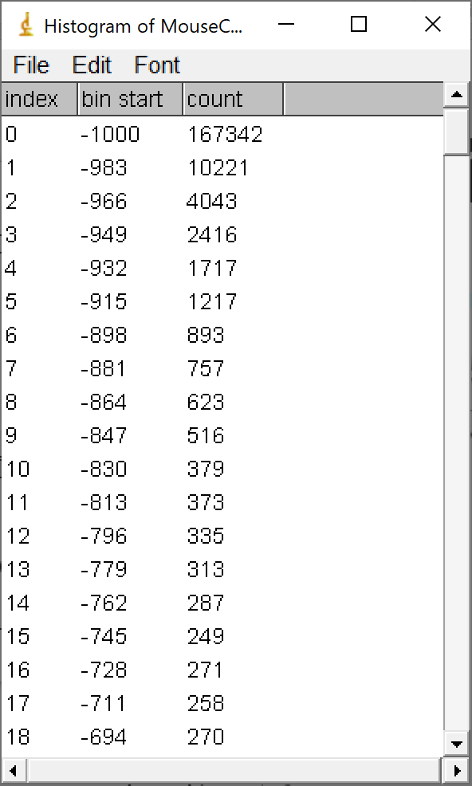
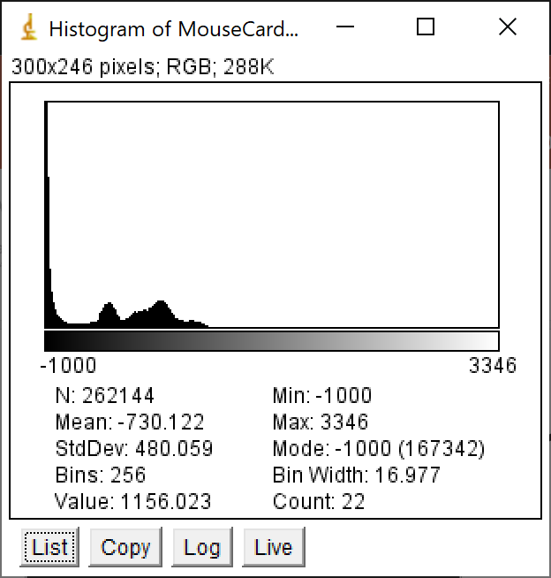
Histogram

Slide 13
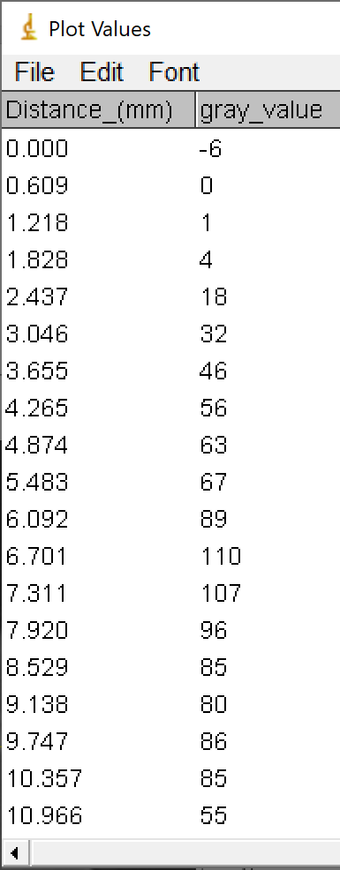
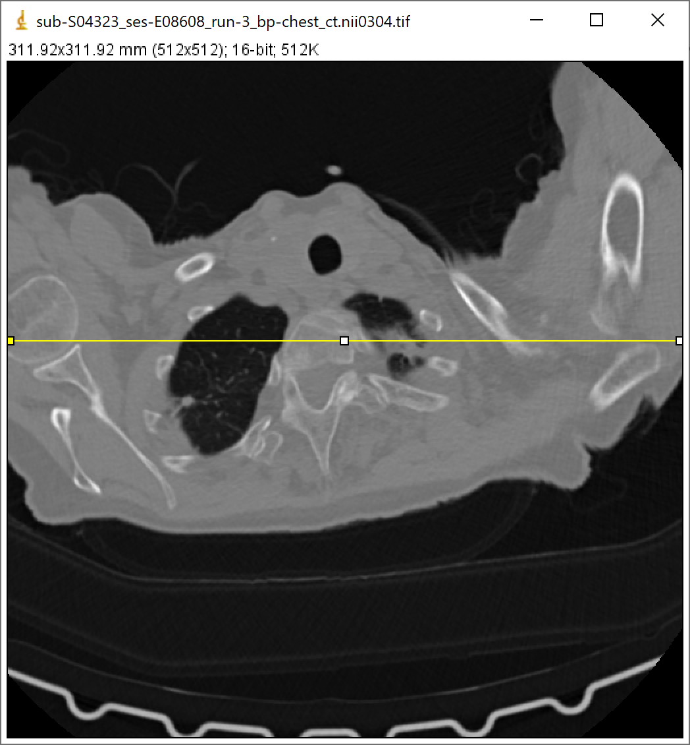
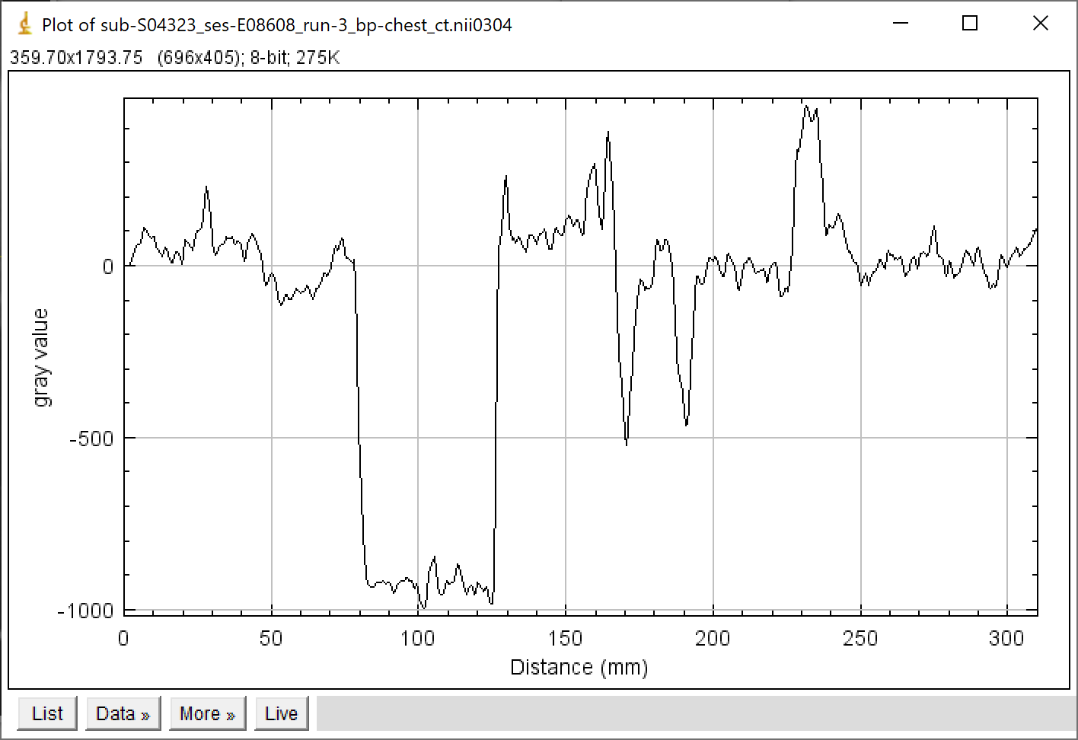
Line Intensity Profile

Slide 14
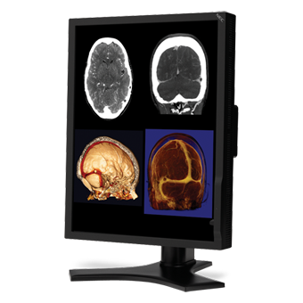

Important Metric of Display Monitor
Resolution
Pixel size/pitch, Retina display
Display size, 2k, 4k, 8k
Grey-scale/Color-scale range
Bit depth, 8-bit, 12-bit, 16-bit
Gamma curve
Luminance/brightness
Luminance is defined as the ‘absolute quantity of radiation emitted from a given source of visible electromagnetic radiation.
Medical displays provide much higher luminance than consumer displays.
Contrast Ratio
Defined as the ratio of the white luminance to black luminance.
Viewing angle, Refresh rate, Response time, uniformity/bad pixels.
Notes:
https://www.ncbi.nlm.nih.gov/pmc/articles/PMC2765178/

Slide 15

Display Monitor Color Scale
Display Monitor
grayscale
color scale
Monitors are typically RGB-colored devices, with separate red, green, and blue dots. Each dot can be set to 256 different brightness levels (8 bits), so 24 bits define a color (16 million possible RGB colors).
To get grayscale, you set all three colors to the same value, so there are only 256 possible shades of gray.
Notes:
Monitor color depth, ADC bit depth

Slide 16
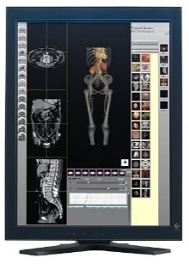
Why 256?
Human eyes normally can only perceive up to 256 shades of grey (i.e. human limit).
Professional diagnostic monitor can have >256 (8 bits) grey scales.
Medical images are inherently grey-scale images, but pseudo colors can be used to render “realistic” images.
Notes:
Pseudo colors = 伪彩色

Slide 17
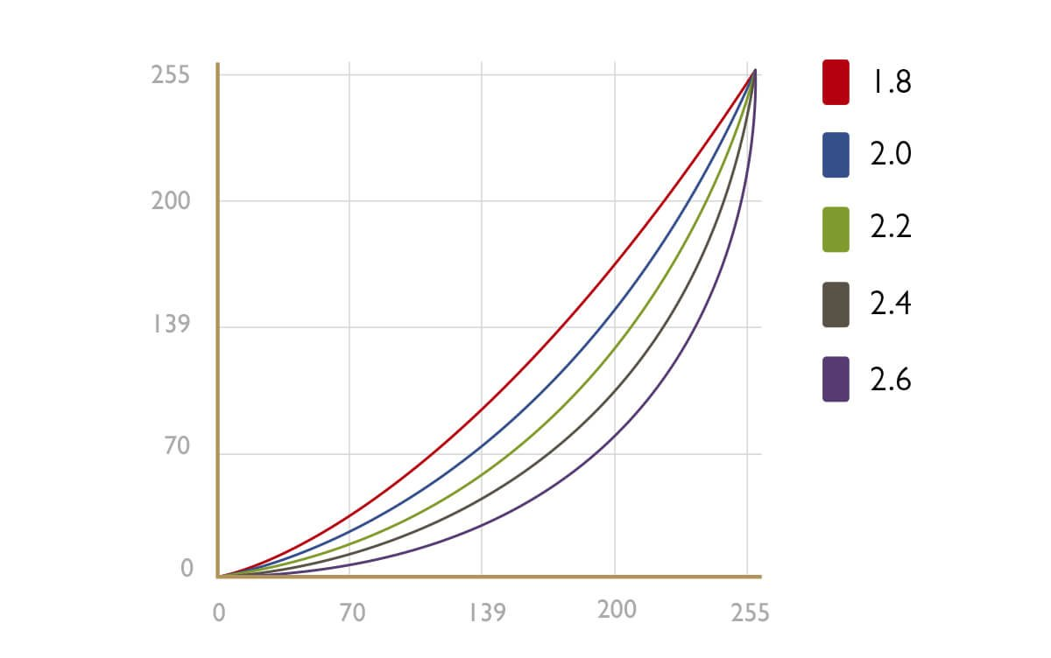
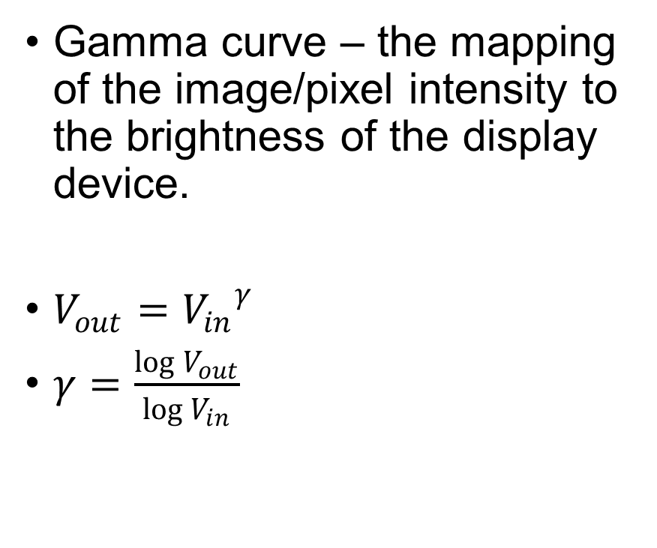
Gamma Curve of Display Devices
Gamma curve – the mapping of the image/pixel intensity to the brightness of the display device.
$V_{out}={V_{in}}^{γ}$
$γ=\frac{\log{V_{out}}}{\log{V_{in}}}$
Vout
Vin

Slide 18
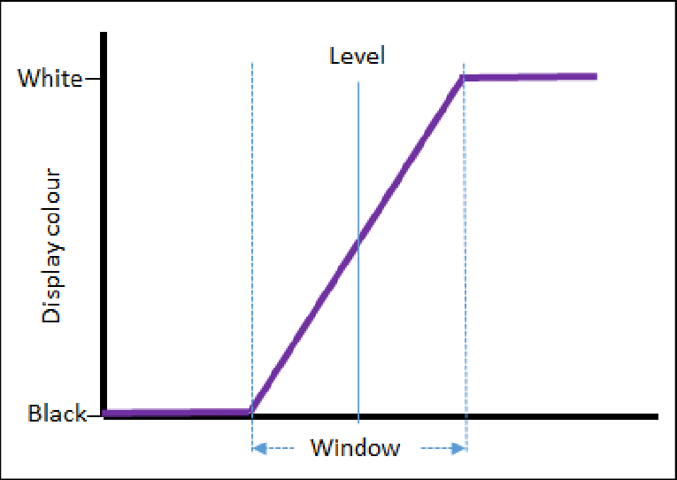
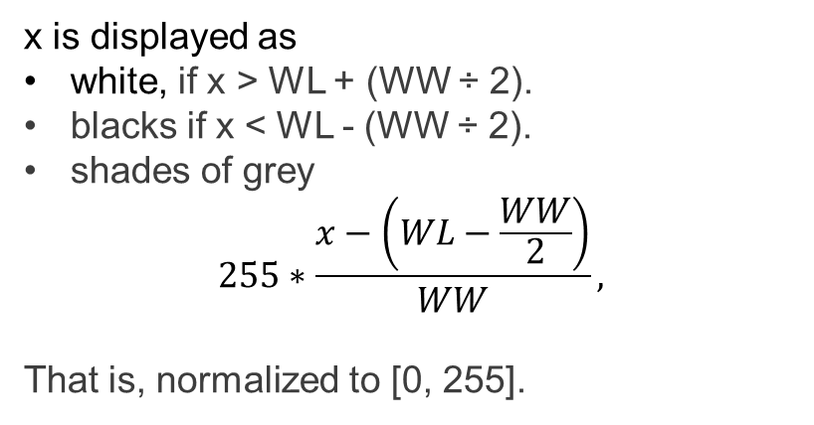
Image Display Window & Level
Center of the range =
Window Level (WL)
The range pixel values in medical images can be >> 256.
To display a medical image,
the upper grey level (x) is calculated via WL + (WW ÷ 2).
the lower grey level (y) is calculated via WL - (WW ÷ 2).
Change WW and WL will change image contrast and brightness, respectively.
WW controls contrast; Larger WW leads to smaller contrast.
WL controls brightness.
x is displayed as
white, if x > WL + (WW ÷ 2).
blacks if x < WL - (WW ÷ 2).
shades of grey
$$255∗\frac{x−\left(WL−\frac{WW}{2}\right)}{WW},$$
That is, normalized to [0, 255].
x
Range of the pixel numbers = Window Width (WW)

Slide 19
Window/Level Example
Mapping function:
L - display window level
W - display window width
Imax - maximum intensity scale of the display device (for an 8-bit display device, Imax = 255).

Slide 20
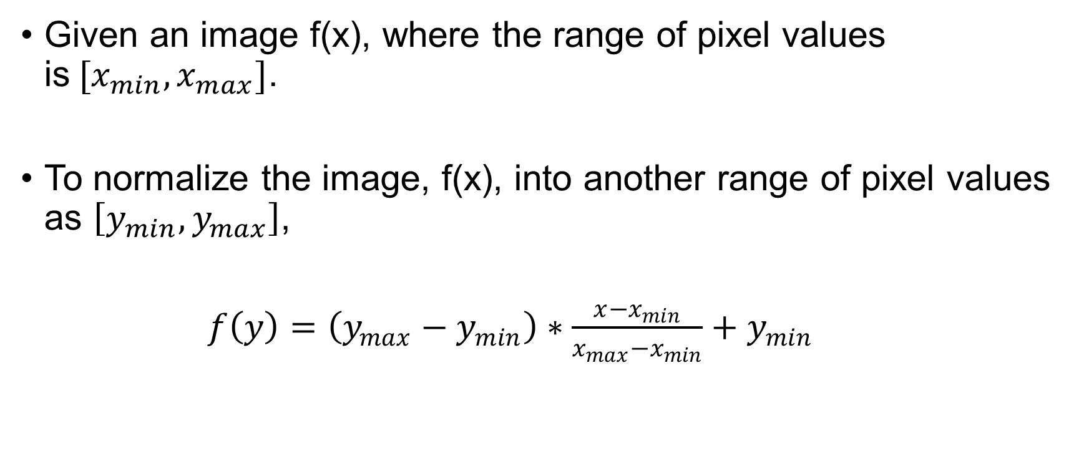
Image Normalization
Given an image f(x), where the range of pixel values is$[x_{min}, x_{max}]$.
To normalize the image, f(x), into another range of pixel values as $\left[y_{min}, y_{max}\right]$,
$f\left(y\right)=\left(y_{max}−y_{min}\right)∗\frac{x−x_{min}}{x_{max}−x_{min}}+y_{min}$

Slide 21
Lecture 2: Foundation of Biomedical Imaging
Common concepts in biomedical imaging
United view of imaging technologies
Current clinical practice of medical imaging
Image Storage: PACS & DICOM
Introduction to ImageJ
An image is a matrix!
Histogram
Image Display: Display Monitor, Window/Level
Image normalization
Terminologies in 2D & 3D imaging
Axial, Coronal, Sagital
MPR, Curved MPR, Volume Rendering, MinIP/AIP/MIP

Slide 22
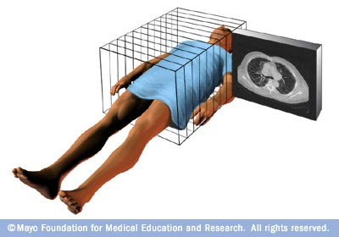
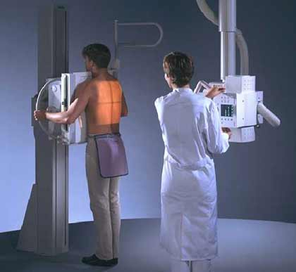
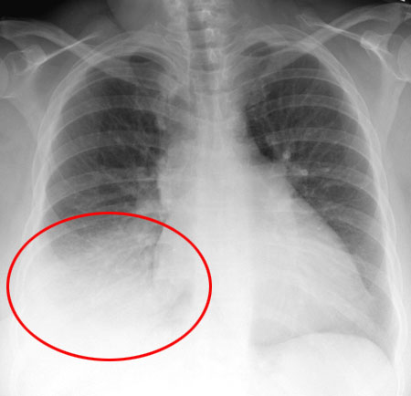
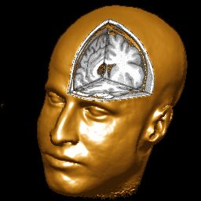
Imaging in 2D & 3D
2D Projection
3D Tomography
Many slices make up a volume in 3D tomographic imaging.

Slide 23
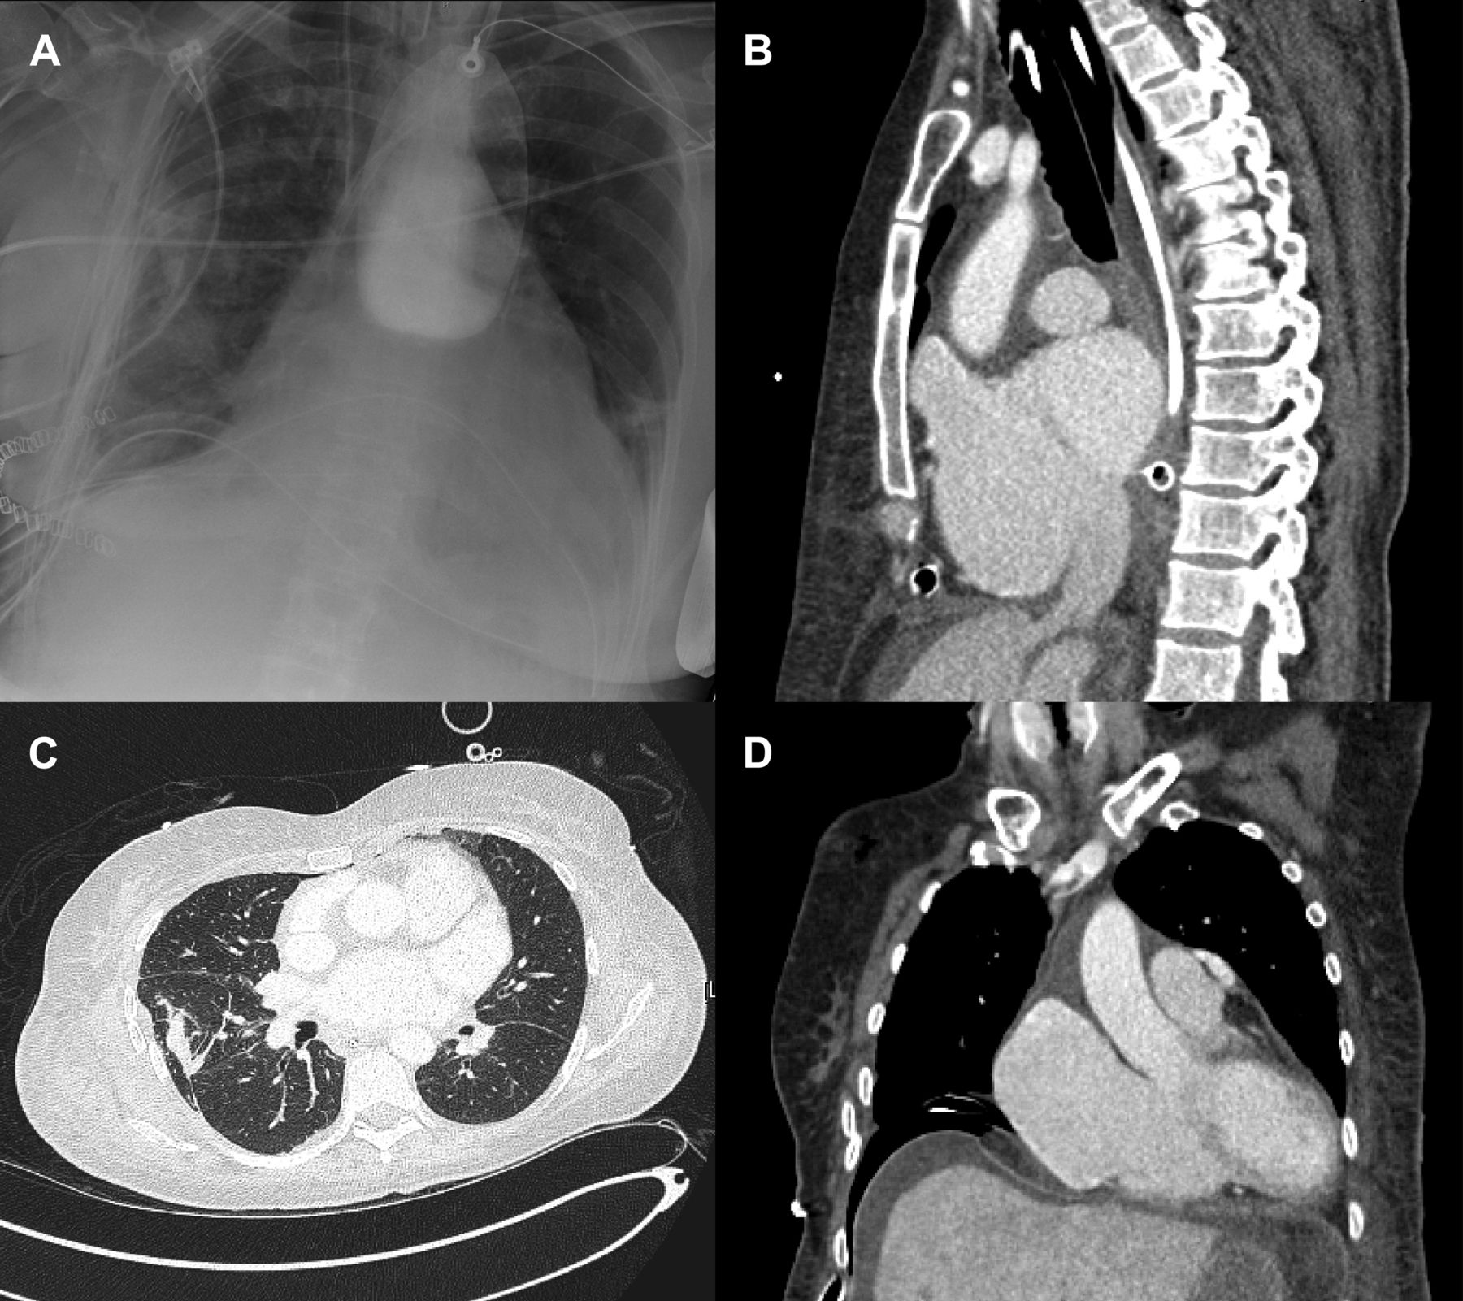
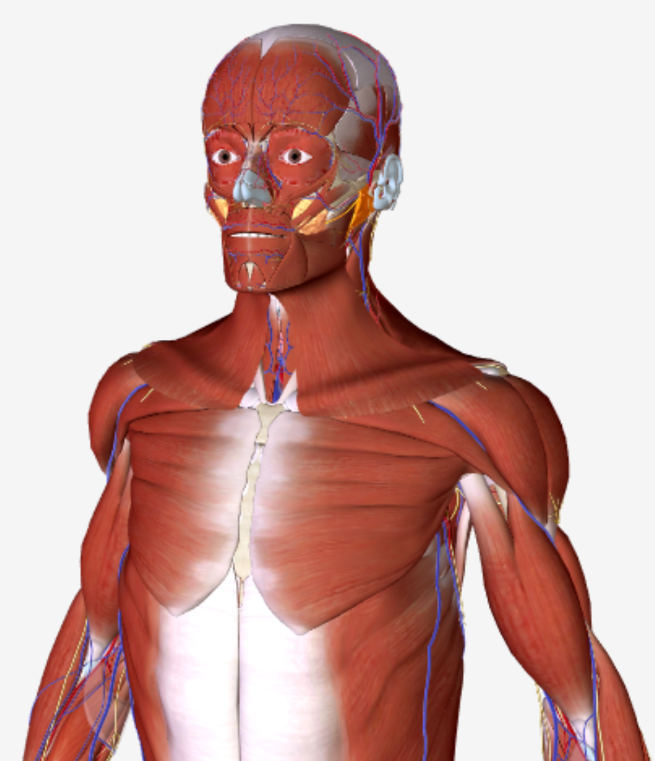
Displaying 2D & 3D images
X-ray (2D)
Sagittal Slice (3D)
Axial Slice (3D)
Coronal Slice (3D)

Slide 24
MPR (Multiplanar Reformation) & Volume Rendering
Curved Planar Reformation
right coronary artery
Minimum/Average/Maximum Intensity Projection
Reading Assignment: “Introduction to the Language of 3D Imaging with MDCT” by Dalrymple et al.

